Slide 1

Space Y: Viability Analysis to Compete with SpaceX
This presentation evaluates the viability of Space Y competing with SpaceX. We'll cover methodologies, key findings, and actionable insights to predict successful rocket landings and identify optimal launch locations.
by Sai Vinay

Slide 2

Executive Summary: Key Findings
Data Collection
Valuable data was collected from public sources using web scraping and the SpaceX API.
Exploratory Data Analysis (EDA)
EDA identified the best features for predicting launch success, including data wrangling and interactive visual analytics.
Machine Learning Prediction
The best model for predicting important characteristics to drive opportunities was identified using collected data.

Slide 3
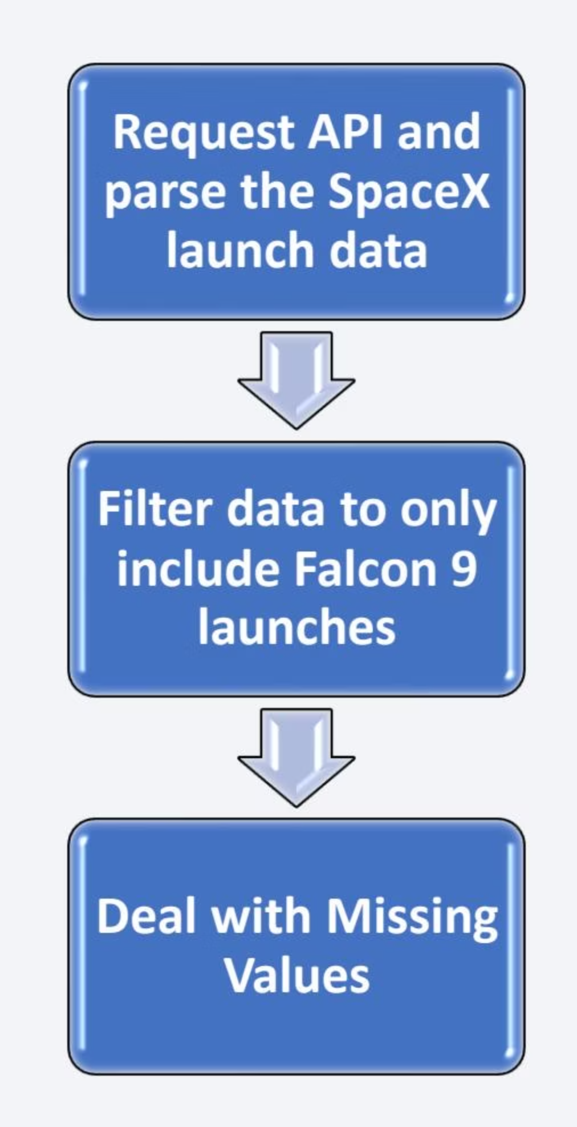
Methodology: Data Collection
Data from SpaceX was obtained from two primary sources:
SpaceX API: https://api.spacexdata.com/v4/rockets/
Web Scraping: Wikipedia (https://en.wikipedia.org/wiki/List\_of\_Falcon/\_9/\_and\_Falcon\_Heavy\_launches)
Collected data was enriched by creating a landing outcome label based on outcome data after summarizing and analyzing features.

Slide 4
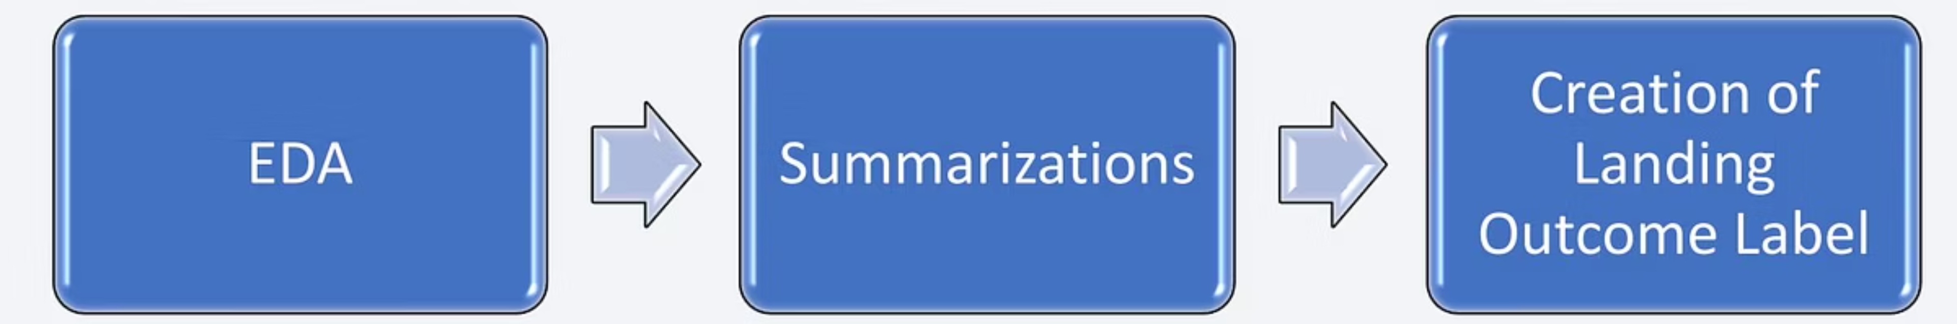



Methodology: Data Analysis
Exploratory Data Analysis (EDA)
Performed using visualization (scatterplots, barplots) and SQL queries to understand feature relationships and summarize launches.
Interactive Visual Analytics
Utilised Folium for interactive maps (markers, circles, lines, clusters) and Plotly Dash for dashboards (launch percentages by site, payload range).
Predictive Analysis
Classification models (logistic regression, SVM, decision tree, k-NN) were evaluated for accuracy using normalised and split data.

Slide 5

Results: Key Findings from EDA
SpaceX uses 4 different launch sites, with first launches for SpaceX and NASA.
Average payload of F9 v1.1 booster is 2,928 kg.
First successful landing occurred in 2015, five years after the first launch.
Many Falcon 9 booster versions successfully landed in drone ships with above-average payloads.
Almost 100% mission success rate, with landing outcomes improving over time.

Slide 6
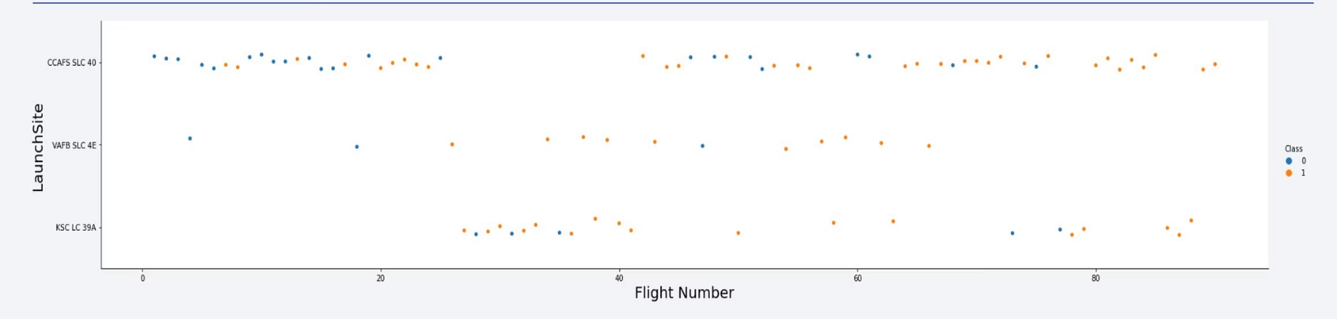
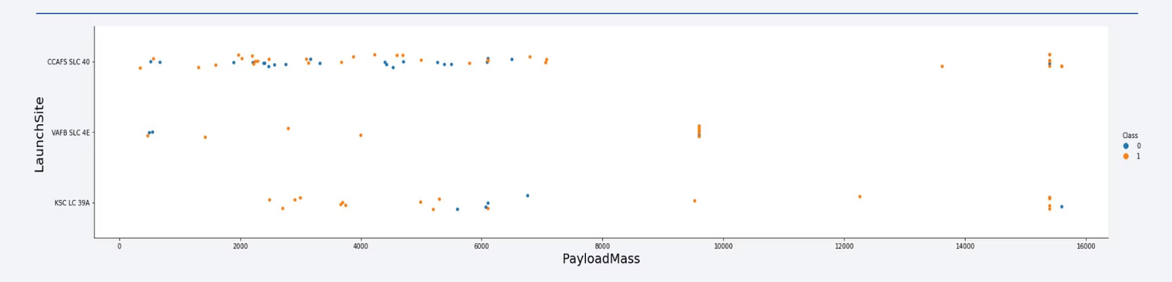
Results: Launch Site and Payload Analysis
Launch Site Performance
Payload Success
CCAFS SLC 40 is currently the best launch site, followed by VAFB SLC 4E and KSC LC 39A. General success rates have improved over time.
Payloads over 9,000kg show excellent success rates. Payloads over 12,000kg are primarily possible from CCAFS SLC 40 and KSC LC 39A.

Slide 7
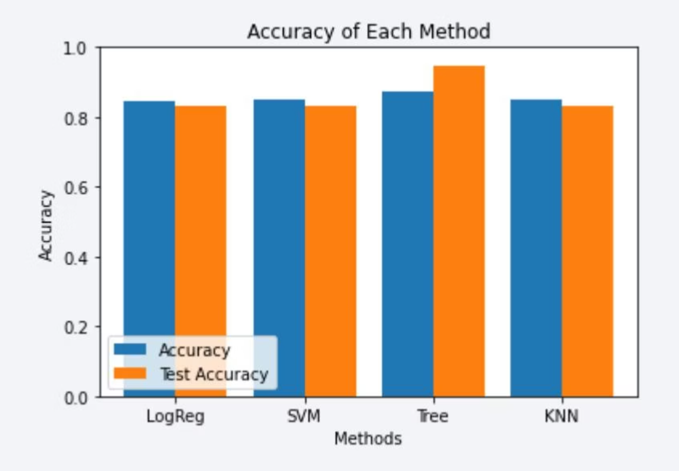
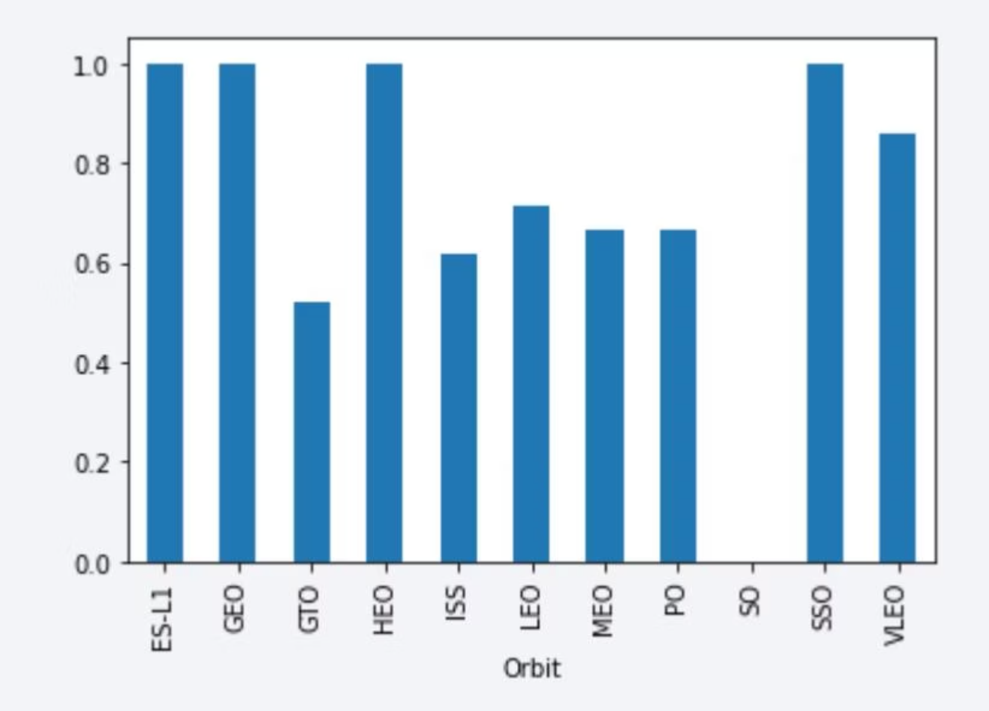
Results: Orbit Type and Predictive Analysis
Orbit Success Rates
Predictive Model
Highest success rates for ES-L1, GEO, HEO, and SSO orbits. VLEO shows new business opportunity due to increased frequency. Success rates improved over time for all orbits.
Decision Tree Classifier is the best model for predicting successful landings, with over 87% accuracy and 94% accuracy for test data.

Slide 8

Conclusion and Next Steps
Key Takeaways
Recommendations
Future Improvements
KSC LC-39A is the best launch site. Launches above 7,000kg are less risky. Successful landing outcomes are improving. Decision Tree Classifier can predict successful landings and increase profits.
Focus on KSC LC-39A for high-payload missions. Leverage Decision Tree Classifier for strategic launch planning. Consider VLEO orbit as a new business opportunity.
Set a value for np.random.seed for model tests. Address Folium map display issues on GitHub for better sharing.

